Slide 1
A Detailed Look into Belarus Used Car Market
By : Team Pattern 6
Kartik Jain
Aasish Kumar
Aihan Liu
Ali Can Mutlu
Kurtis Shen

Slide 2
Agenda
Introducing the Topic
Data Pre-Processing
EDA
Showcasing the Graphs
Hypothesis Testing
Questions

Slide 3
Research Proposal
What factors determine the prices of cars in the used car market?
Manufacturer Name?
Color?
Engine Capacity?
Odometer Value?
Engine Type?
Year Produced?

Slide 4
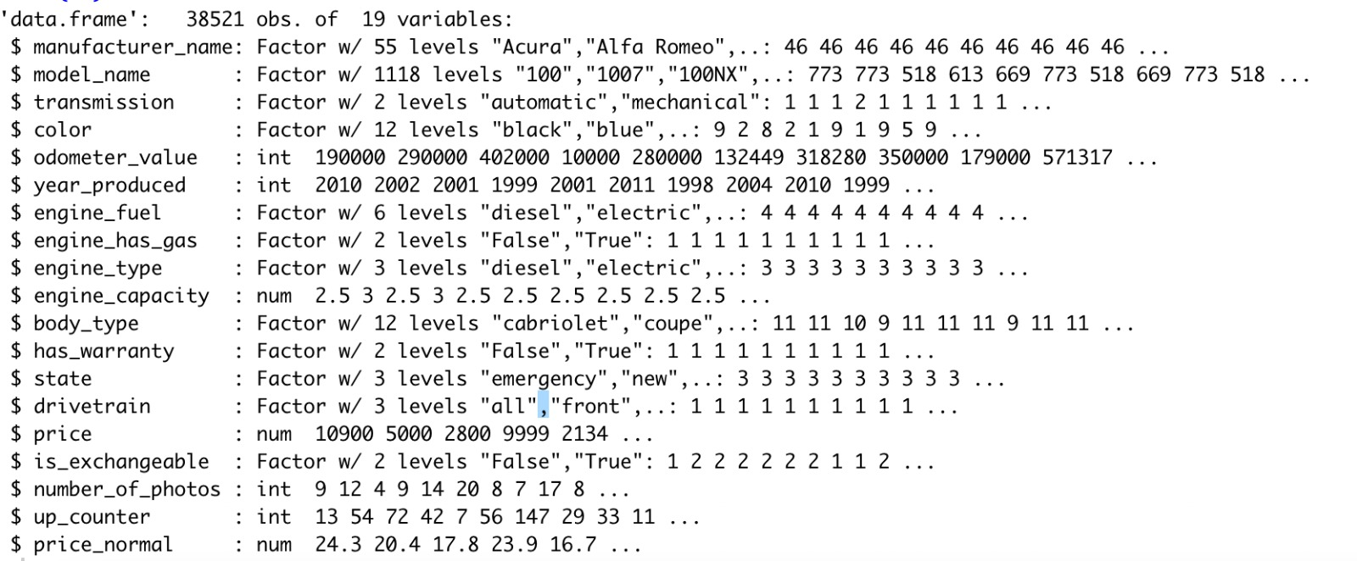
Data Set Information
Used car catalog for Belarus for the year 2019
Source: Kaggle
No. Observations: 38521
No. of variables: 19
MeanPrice: 6639.97$
Std.DevPrice=6428.15$

Slide 5
Data Pre-Processing
Dropping Null Values : engine_capacity(10)
Factor Checking
Name Change: Price USD – Price

Slide 6
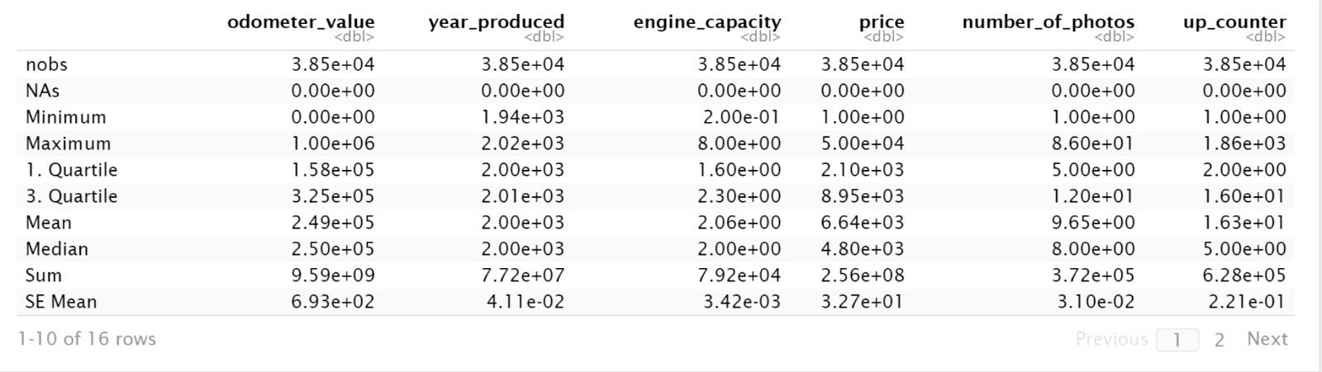
Descriptive – Basic Statistics for the Variables

Slide 7
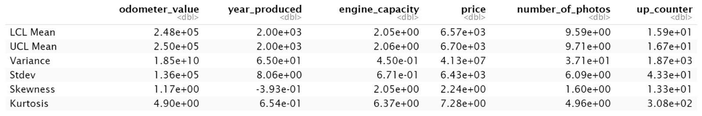
Descriptive – Basic Statistics for the Variables
Notes:
Highlight Standard Deviation

Slide 8
Exploratory Data Analysis

Slide 9
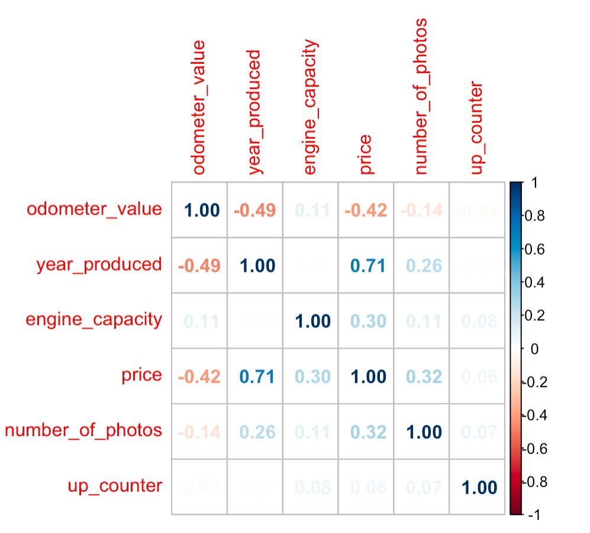

Correlation Plot

Slide 10
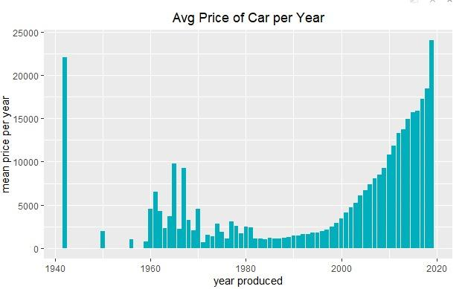
Mean Price of Car vs Year Made – Do you see anything interesting?
Notes:
Add an arrow to the left side

Slide 11
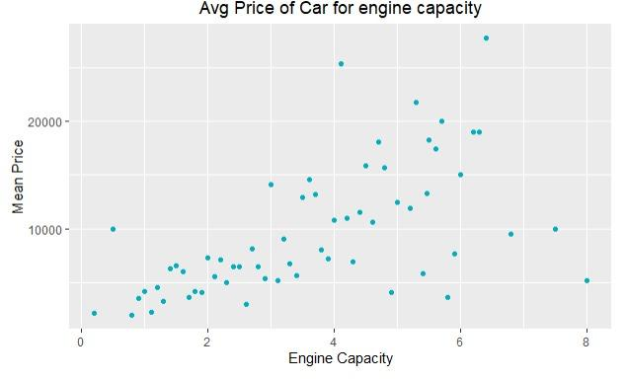
Mean Price of Car vs Engine Capacity
- Do you see anything interesting?
Correlation Coefficient: 0.6

Slide 12
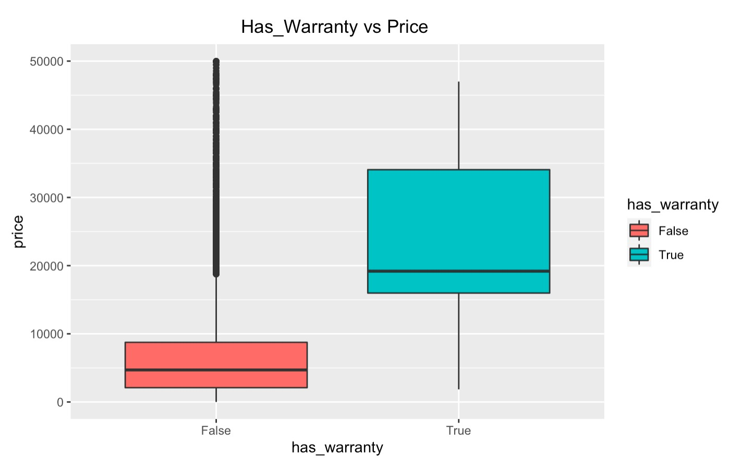
Has_Warranty vs Price
t = 37, df = 452, p-value <2e-16
T-Test Results
Notes:
add a portrait type box

Slide 13
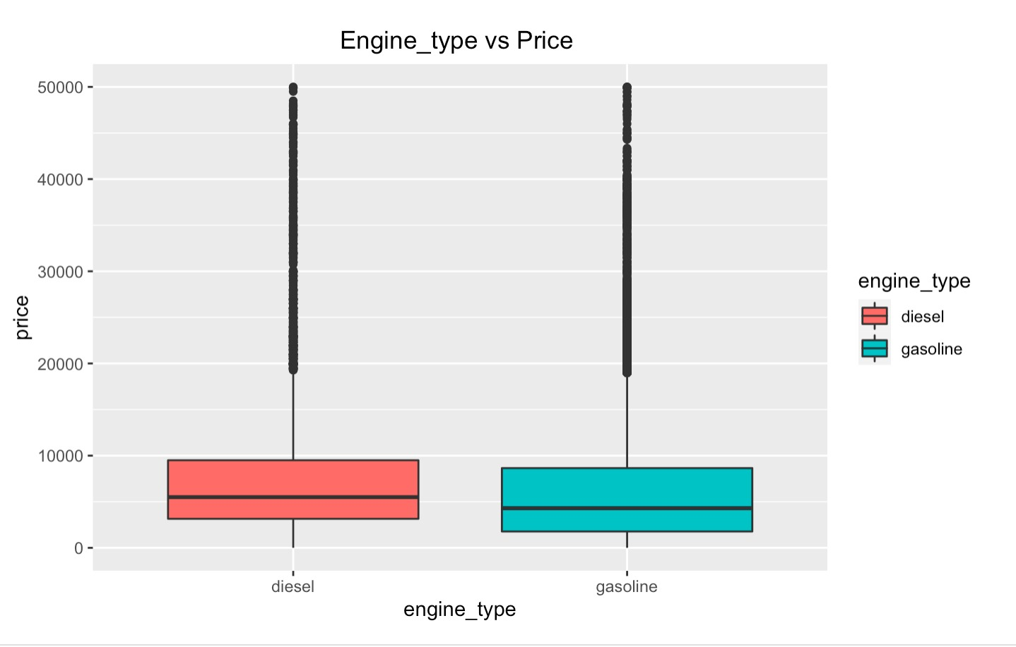
Engine_Type vs Price
t = 16, df = 24452, p-value <2e-16
Notes:
Edit this to make it exactly the same as the previous one

Slide 14
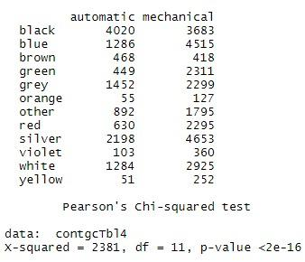
Colors vs Transmission

Slide 15
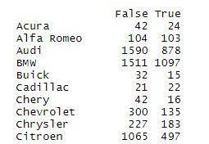
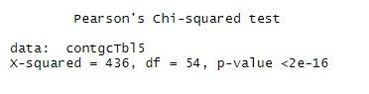
Manufacturer Name vs Is_Exchangable

Slide 16
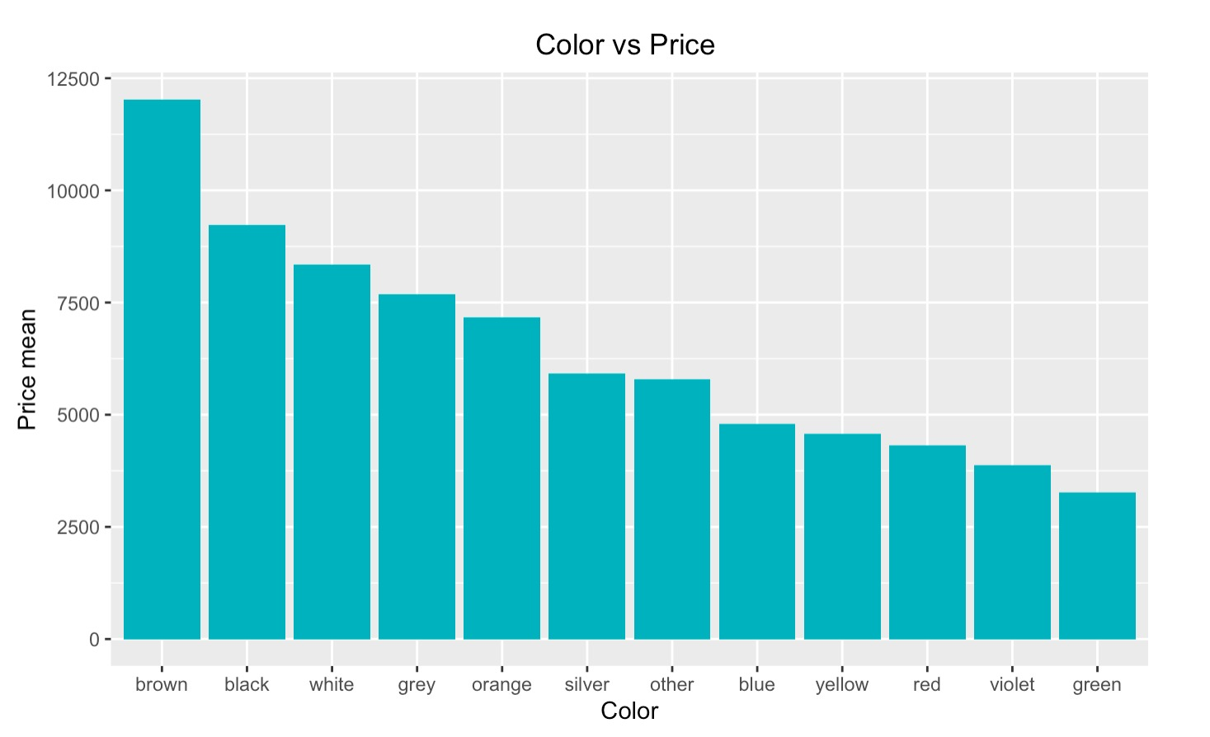
The Price Difference Between Different Colors
## Df Sum Sq Mean Sq F value Pr(>F)
## color 11 1.70e+11 1.55e+10 420 <2e-16 ***
Notes:
dont forget to mention that it is mean price

Slide 17
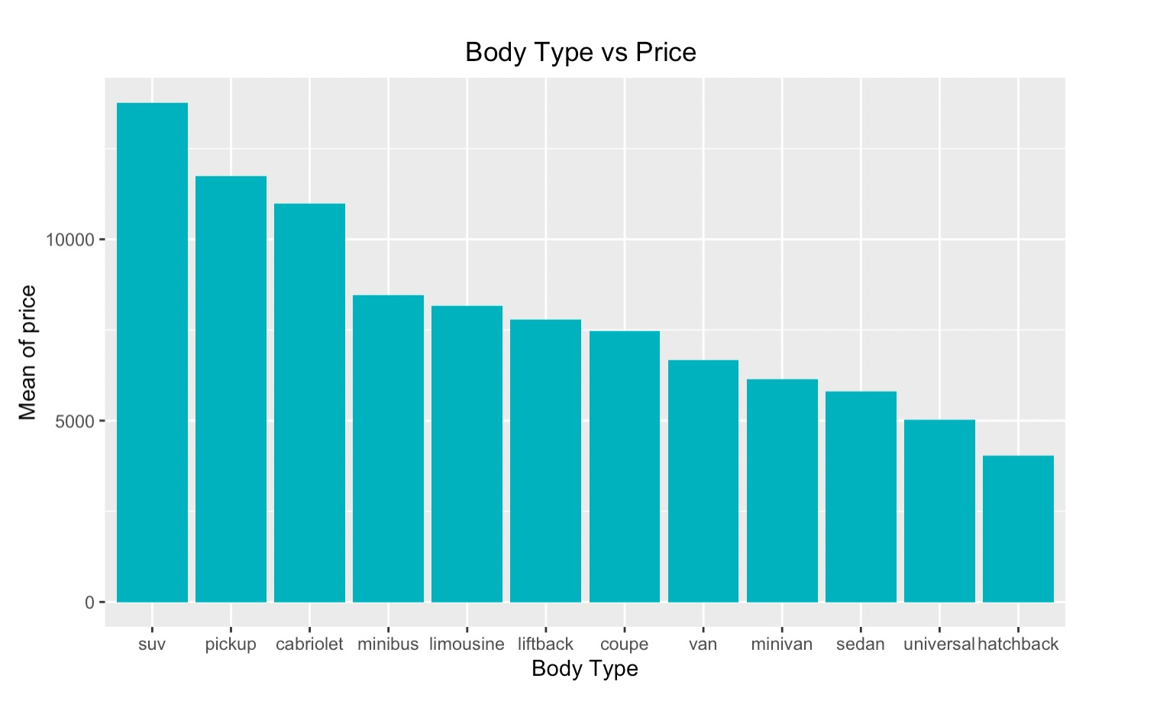
Change in Price and Body Type
## Df Sum Sq Mean Sq F value Pr(>F)
## body_type 11 3.50e+11 3.18e+10 988 <2e-16 ***
Notes:
dont forget to mention its mean price

Slide 18
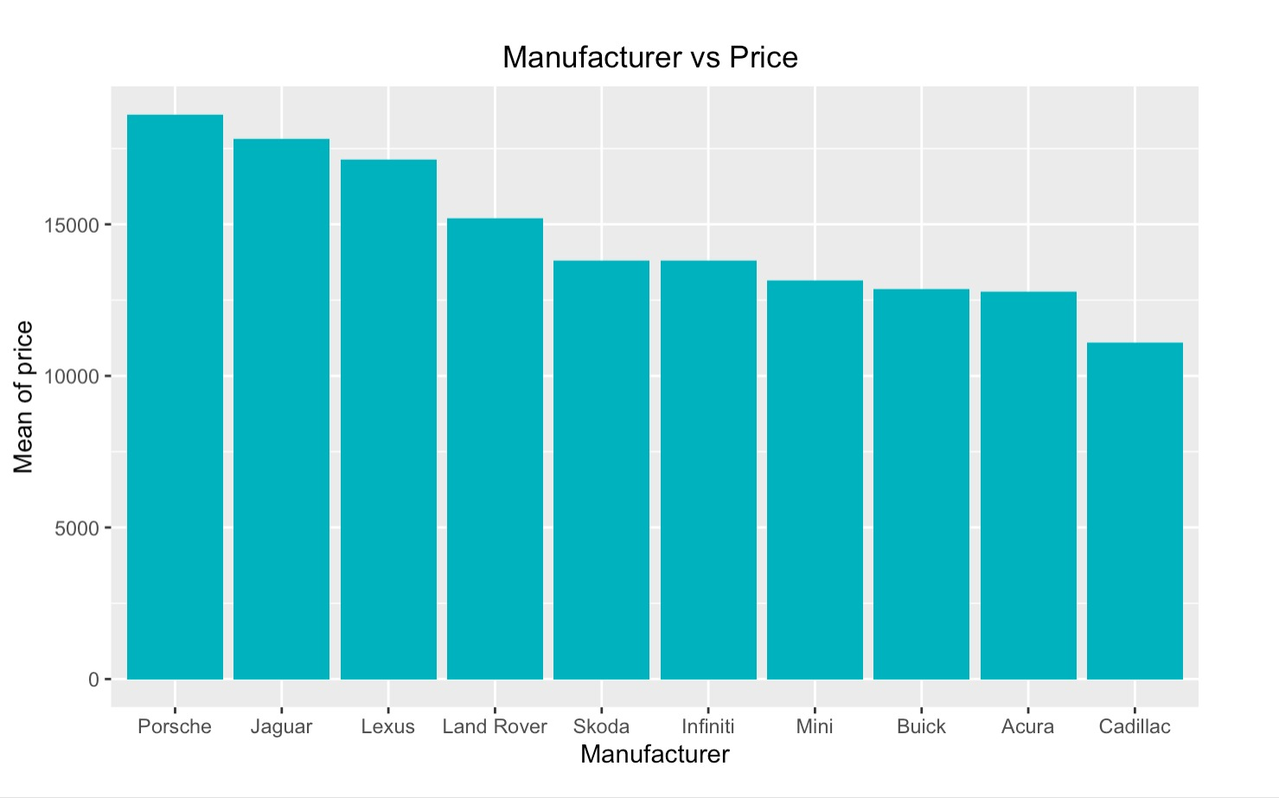
Relationship Between Price and Top 10 Manufacturers
## Df Sum Sq Mean Sq F value Pr(>F)
## manufacturer_name 54 2.94e+11 5.45e+09 162 <2e-16 ***
Notes:
Dont forget to mention that it is mean price

Slide 19
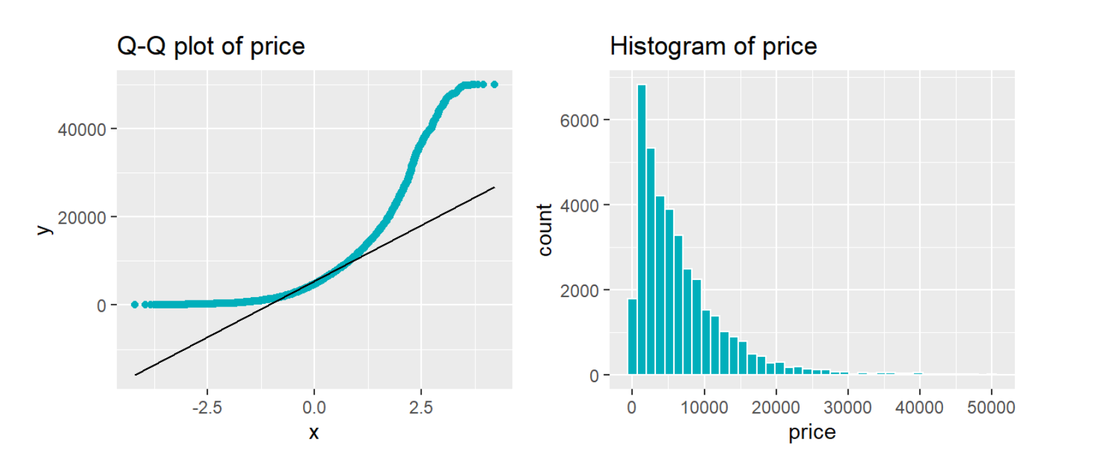
Q-Q Normalization
## One-sample Kolmogorov-Smirnov test
## D = 0.2, p-value <2e-16
## alternative hypothesis: two-sided

Slide 20
What is the story?
year_produced
Manufacture_name
odometer_value
color
transmission
engine_type
engine_capacity
body_type
Price

Slide 21
Data Transformations

Slide 22
Normalizing the Target Variable

Slide 23
Outlier Checking

Slide 24
4 Models

Slide 25
1st Base Model

Slide 26
2nd Model Polynomial Term for Continous Variable

Slide 27
3rd Model Both Interaction Terms

Slide 28
4th is Final Model

Slide 29
Partial Least Square Model

Slide 30
Rich and Lasso Regression

Slide 31
Hypotheses Test

Slide 32
ANOVA

Slide 33
Tukey Testing

Slide 34
Prediction

Slide 35
Questions?

